Slide 1

AUTOMATED PRIMAVERA P6 PROGRESS REPORTING
Automatic monthly progress reporting, produced quickly, repeatably and precisely.
Upload your P6 programme each month. Get the dashboard, DCMA check, NEC4 report and every pack, automatically.
Gavin Morris, Founder · p6pulse.com
Notes:
Open with the problem every planner in the room recognises: the monthly report. P6 Pulse takes the grunt work out of it, so planners can spend their time planning.

Slide 2

THE PROBLEM
Every month, reporting eats the time meant for planning
Compare the update
Check the quality
Rebuild the tables
Write the narrative
Logic, constraints, float and invalid dates, before the client's reviewer finds them.
Milestones, S-curves, look-aheads and registers, recreated in spreadsheets every period.
The same contractual report, written again from scratch each month.
Line by line against last month, looking for what moved and what quietly changed.
Skilled planners doing clerical work, on every project, every period.
p6pulse.com
Notes:
Ask the room how long their monthly report takes, from receiving the progressed programme to issuing the report. Let them name the parts they would happily never do by hand again.

Slide 3

THE ANSWER
One upload. Every report your project needs.
P6 Pulse produces the dashboard, changes in period, DCMA check, NEC4 report and packs automatically, so planners can spend their time planning.
Notes:
This is the whole pitch in one line. Everything that follows shows how P6 Pulse delivers it.

Slide 4
HOW IT WORKS
Five steps, and most of them happen once
01
02
03
04
05
Set up the project
Upload the baseline
Upload each update
Review the reports
Share and export
Contract details, parties, DCMA limits and who receives the reports.
The accepted programme, as XER or P6 XML, uploaded once.
The progressed programme, plus photos, early warnings and CEs.
Dashboard, changes, DCMA check and a draft NEC4 narrative, in minutes.
Word, Excel and PowerPoint packs, emailed and published to the portal.
Steps 1 and 2 happen once. Steps 3 to 5 are the monthly routine, and you keep working in Primavera P6 exactly as you do today.
p6pulse.com
Notes:
Set-up and the baseline are one-off. After that, the monthly routine is upload, review and share. Navy bars mark the one-off steps; orange marks the monthly routine.

Slide 5
Every report your project needs
Performance dashboard
Changes in period
DCMA 14-point check
SPI, BEI, CPLI, float erosion, milestones and S-curves.
Added, deleted and edited activities, flagged automatically.
Full quality check, with the activities behind each failure.
NEC4 programme report
EW and CE registers
Photo timeline
Clause 31/32 report with an AI-drafted narrative to review.
Early warnings and CEs, in or out of the forecast, your call.
Site photos linked to activity IDs, month by month.
Word, Excel, PowerPoint
Customer portal
Portfolio dashboard
The whole month's pack, downloaded in one click.
Read-only stakeholder access, with every view logged.
Every project's SPI, forecast and float on one screen.
p6pulse.com
Notes:
Nine outputs from one monthly upload. The next few slides pick out the ones buyers ask about most: the dashboard, changes and DCMA, the NEC4 report and the portal.

Slide 6
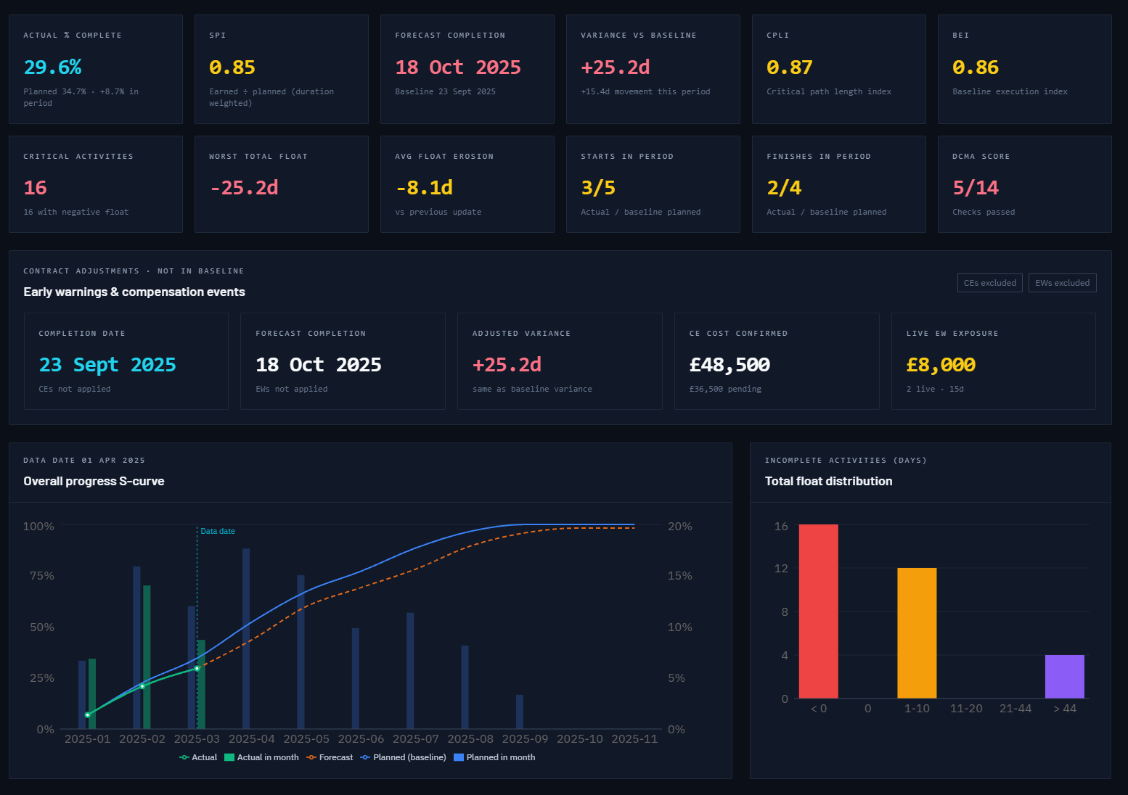
PERFORMANCE DASHBOARD
Performance, calculated from every update
SPI, BEI and CPLI
Forecast against baseline
Float erosion and distribution
EWs and CEs, in or out
S-curves by month
The live demo project, NEC4 ECC Option C.
p6pulse.com
Notes:
This is the live demo dashboard, calculated automatically from the project's P6 updates; nobody built it in a spreadsheet. Point out the forecast against baseline, the EW and CE panel with its in-or-out toggle, and the S-curve. Best shown live at p6pulse.com/demo.

Slide 7
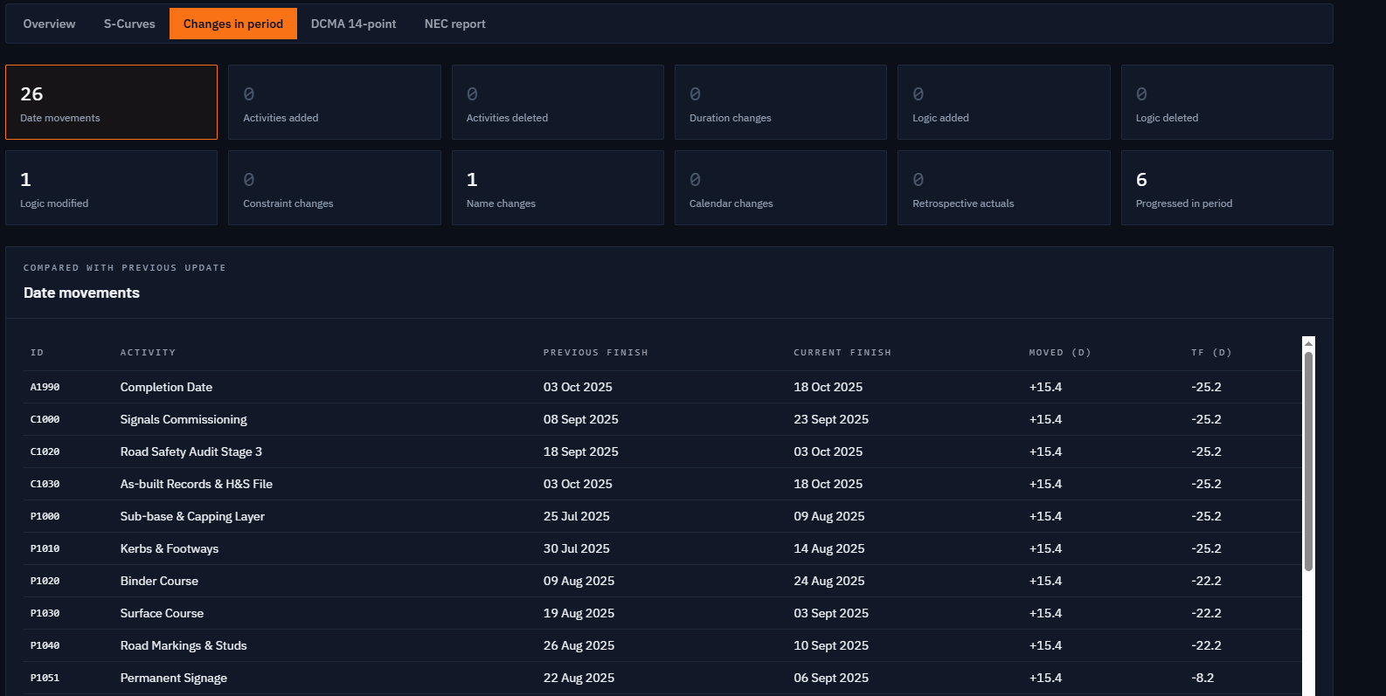
CHANGES IN PERIOD AND DCMA
Nothing slips through
Changes in period
Every update compared with the last: dates, activities, logic, durations, constraints, calendars and retrospective actuals.
DCMA 14-point check
Limits you set per project, with the activities behind each failure listed for fixing in P6.
p6pulse.com
Notes:
On a programme with thousands of activities, something always gets missed in a manual comparison. Here the demo shows 26 date movements, a logic change, a name change and six activities progressed, each listed with previous and current dates. The DCMA check works the same way: every failure comes with the activities causing it.

Slide 8
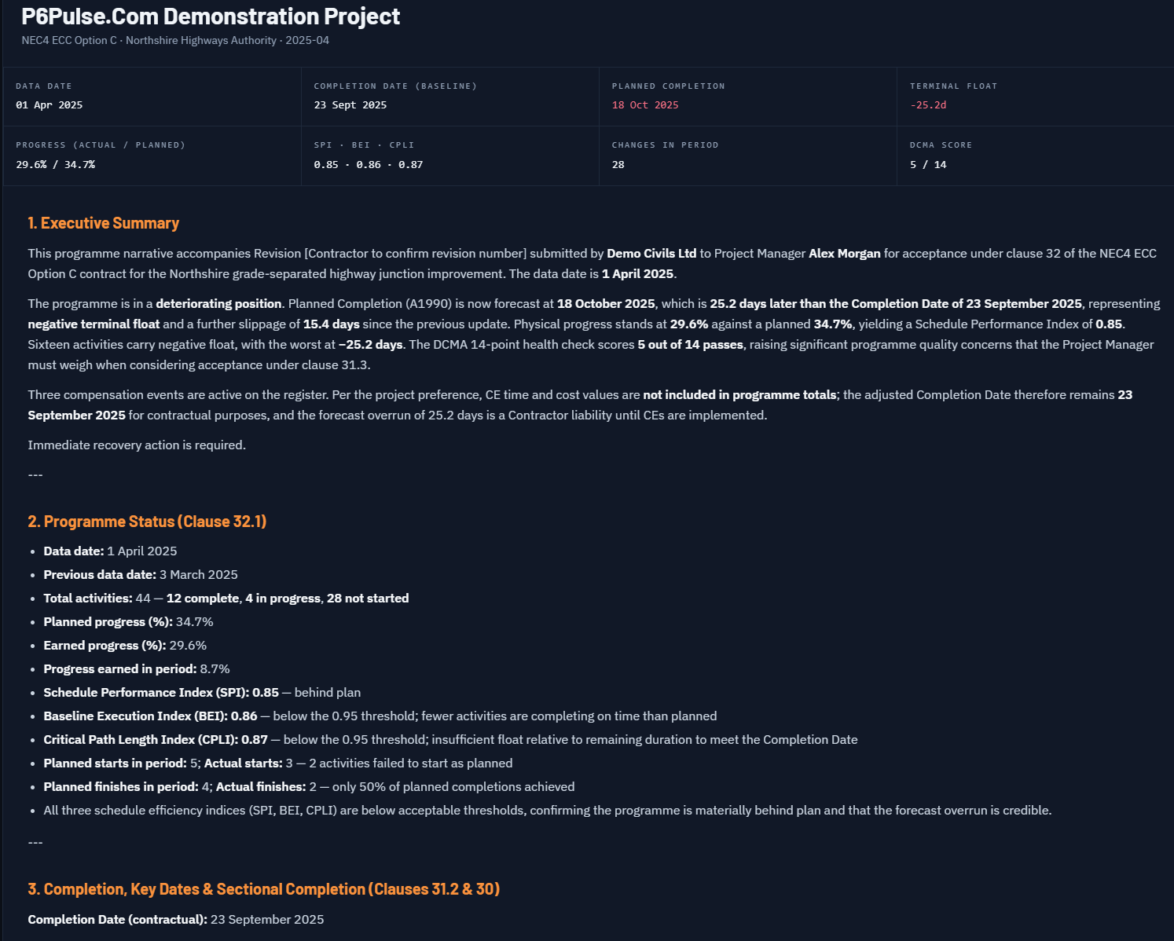
NEC4 PROGRAMME REPORT
The Clause 31/32 report, drafted from the programme
The narrative is drafted by advanced LLM from your programme data, so the report and the programme always say the same thing. You review it, adjust it and submit it, in Word or PDF.
Early warnings and CEs sit in registers alongside, and you choose whether each counts in the forecast.
p6pulse.com
Notes:
For UK NEC work this is usually the headline. The planner stays in control: P6 Pulse drafts, the planner decides what is issued. The forecast can be shown with and without compensation events.

Slide 9
SHARING
One version of the truth for every stakeholder
Customer portal
Monthly packs, emailed
Invite-only and read-only, with a record of who viewed and downloaded what.
Word, Excel and PowerPoint, in your colours with your footer, sent automatically.
Photo timeline
Portfolio dashboard
Site photos linked to P6 activity IDs, added to your progress slides.
Every project's SPI, forecast completion, float and register exposure on one screen.
p6pulse.com
Notes:
No more chains of emails asking which version is current. Everyone sees the same committed figures, and the portfolio view gives directors every project on one screen.

Slide 10
WHO IT'S FOR
Built for the people who own the programme
Contract parties
A clear, consistent view of performance and Clause 31/32 submissions.
Project controls departments
Standard KPIs, S-curves and DCMA checks across every project.
Planning departments
One repeatable routine for the whole team, with a portfolio view.
Planners
Time spent planning, not formatting.
Primavera P6 users
No change to how you work. Export XER or P6 XML and upload.
p6pulse.com
Notes:
Tailor this to the room. For a contractor, lead with planners and planning departments; for an owner or client team, lead with contract parties and project controls.

Slide 11
SECURITY AND PRIVACY
Your data is yours. Full stop.
Never sold or shared
No AI training
No advertising, no profiling, no data brokers. Ever.
Your files never train AI models, ours or our providers'.
Private, permission-checked storage
You stay in control
Encrypted connections, and no public download links.
Strict separation between customers; delete anything, any time.
p6pulse.com/security
Notes:
A programme is commercially sensitive, so address this before it is asked. The full detail, including the providers that help run the service, is on the security page.

Slide 12
WHO BUILT IT
35+
Built by a planner, for planners
P6 Pulse was created by Gavin Morris, a planner who has worked for owners, managing contractors and contractors on major energy and infrastructure projects worldwide.
years in planning and project controls
North Sea, Russia, Georgia, Kazakhstan, Nigeria, Saudi Arabia, the Sahara and the Falkland Islands
It does the reporting a planner would do, the way a planner would do it.
p6pulse.com
Notes:
Your credibility is the differentiator against software companies. Mention the clients you are comfortable naming, and that you have built reporting tools on site throughout your career.

Slide 13
PRICING
Simple, per-project pricing
SUBSCRIPTION
Baseline plus unlimited monthly updates
KPI dashboard, S-curves and DCMA 14-point check
NEC4 AI programme report and comparison slides
EW and CE registers, documents and photos
Project portal for stakeholders
All Excel exports and emailed monthly packs
£500
per project per month, all features included
p6pulse.com
Notes:
One plan, no tiers to compare. Set it against the planner days spent on reporting each month on a single project.

Slide 14
Thanks for your time, now go and
see it for yourself!
Explore the live demo
p6pulse.com/demo, no sign-up needed
Gavin Morris · info@p6pulse.com · p6pulse.com
Notes:
Close by offering a walkthrough with one of their own programmes; it is the most persuasive demonstration there is. Leave the product sheet behind.

